Slide 1
NATIONAL MINISTERIAL WEBINAR
PROGRESS WITH IMPLEMENTATION OF THE 2025
WATER AND SANITATION INDABA RESOLUTIONS
Presented by: Dr Sean Phillips
Designation: Director-General
VENUE:
ZOOM VIRTUAL PLATFORM
FRIDAY, 10 APRIL 2026
TIME:
10:00 to 13:00

Slide 2
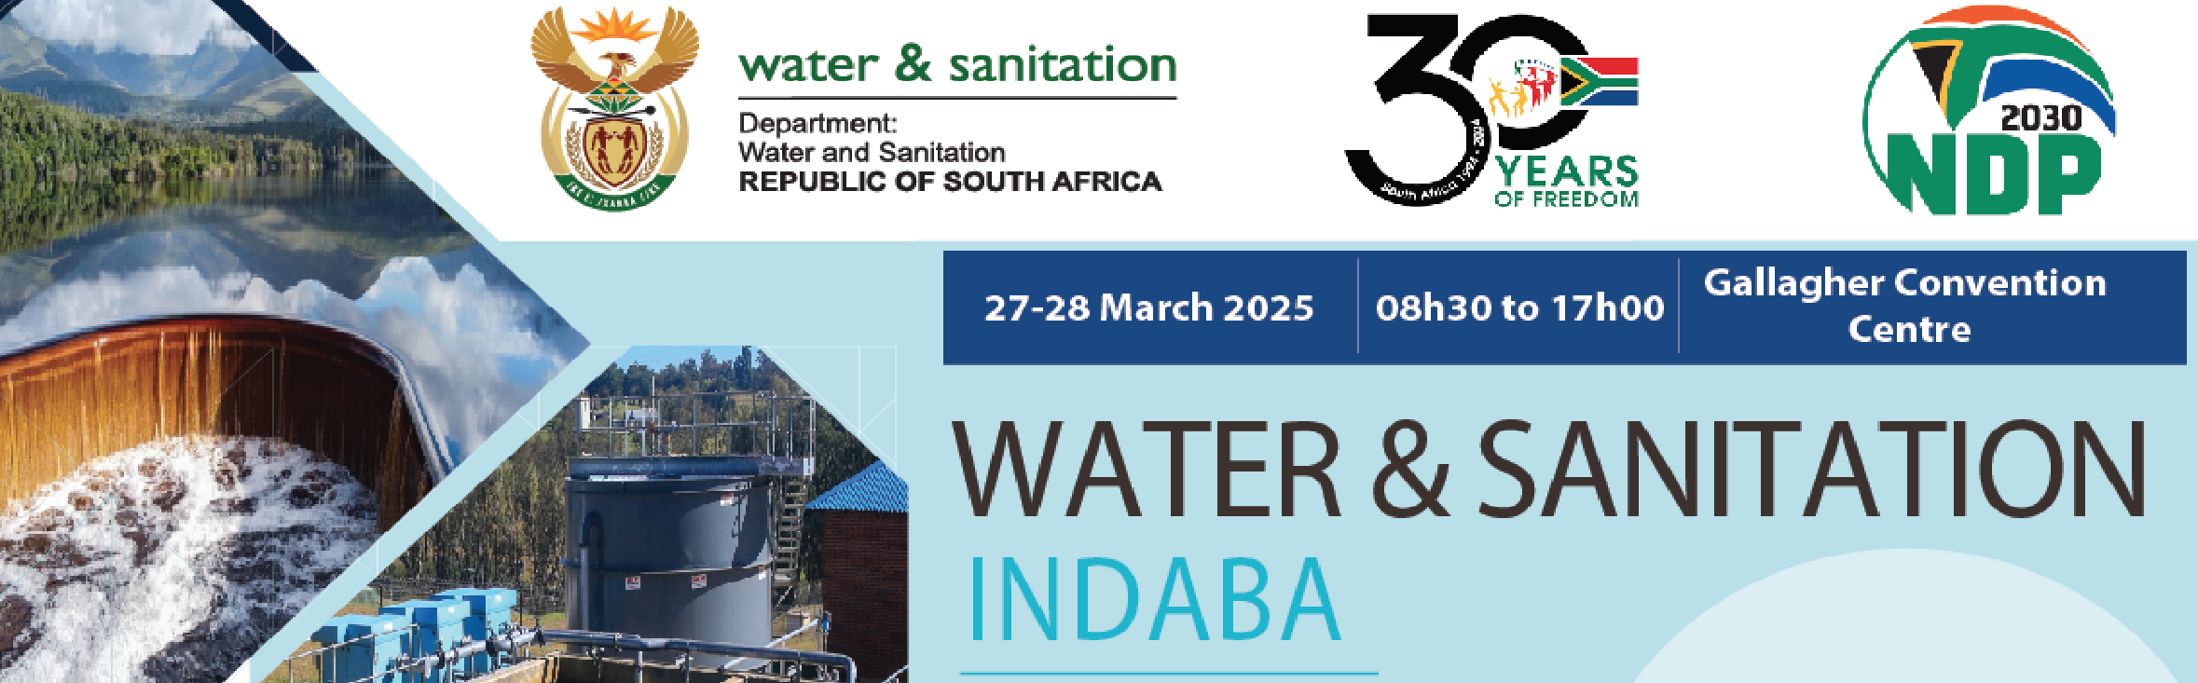
Recap of 2025 Water and Sanitation Indaba
The Water and Sanitation Indaba was attended by 800 delegates, drawn from national government and national entities, provincial government, local government, SALGA, the private sector, and water and sanitation experts. It was also attended by the President and Deputy President
The Indaba agreed on fifty-eight (58) resolutions (see Annexure for full list)
The resolutions are categorised under 5 Themes related to:
delivery/ implementation models (13 resolutions)
increasing investment through financing options and ensuring the financial viability of the sector (17 resolutions)
enhancing and strengthening technical and operational capacity and efficiency (20 resolutions)
building partnerships (4 resolutions)
fighting criminality and corruption in the water and sanitation sector (4 resolutions)
These resolutions formed the basis of our turnaround plan for water and sanitation and was very ambitious with clear timeframes
Effective Regulation
PRESENTATION TITLE
Presented by: Name Surname
Designation: Director
Directorate: Communication Services
Date: 15 April 2019
Presented by: Anet Muir
Designation: CD WUCME
Date:24 09 19

Slide 3
Recap of 2025 Water and Sanitation Indaba
Effective Regulation
Responsibilities for implementation have been assigned to key national government departments, associations and the hundred and forty-four (144) water services authorities (WSAs) responsible for water and sanitation within the local government sphere
This progress report is based on information collected from water services authorities. The data provided by the WSAs has not been independently verified, and some of the WSAs may have overstated their progress.
Progress for each province will be provided separately in more detail on each resolution during the breakaway sessions
PRESENTATION TITLE
Presented by: Name Surname
Designation: Director
Directorate: Communication Services
Date: 15 April 2019
Presented by: Anet Muir
Designation: CD WUCME
Date:24 09 19

Slide 4
Key issues
More than a third of all WSAs have:
Put Non-revenue and Water Conservation and Demand Management programmes in place
Have updated indigent registers
Submitted Corrective Action Plans for critical systems identified in Blue Green and No Drop reports
More than a third of all WSAs have not started with ringfencing nor the implementation of a utility model
Corrective Action Plans are in place but implementation is insufficient
Non-Revenue Water plans have been prepared but again implementation is insufficient
4

Slide 5
Theme 1 Delivery implementation models
To ensure water security in the country the Department has fully established the catchment management agencies (CMAs). All six CMAs have Boards appointed and are fully operational. These are very important to enable the proper management of water catchments by local water users which in turn is critical for water security
DWS is on track to meet the targets and timeframes for full establishment of the South African National Water Resources Infrastructure Agency (NWRIA). Parliament has recently approved the technical amendment of the NWRIA Act. This amendment was essential to enable the operational and financial structuring of the new agency, particularly its replacement of the Trans-Caledon Tunnel Authority
The process of supporting WSAs to engage in Municipal Systems Act Section 78 consultative processes to choose alternative external WSPs has been slow to get off the ground started in October 2025 working with the Water Research Commission
All eight Metropolitan Municipalities are participating in the National Treasury Reform of Metropolitan Trading Services Programme, which includes requiring Metropolitan Municipalities to ringfence revenue from the sale of water for the water function. Very little progress with ringfencing was reported, apart from the metropolitan municipalities
Waterboards are being mobilized to provide more assistance to municipalities e.g. uMgeni-uThukela WB assisting eThekwini MM with wastewater management
5

Slide 6
Theme 1 Delivery implementation models (2)
Approximately 60% of WSAs indicate that they have at least initiated processes to separate the Water Services Authority and Water Services Provider function, with most preferring to retain an internal municipal water service provider mechanism
DWS has tabled the Water Services Amendment Bill in Parliament. The Bill clarifies functions of WSAs and Water Services Providers (WSPs) at municipal level and provides for the licensing of WSPs by DWS as a mechanism to ensure that WSPs have a minimum level of capability. It also provides for the Minister, as a last resort, to legally require a WSA to appoint a licensed WSP of their choice, when the current WSP fails to make progress towards obtaining a license
COGTA is making good progress with the review of the Local Government White Paper
Rand Water and Emfuleni Local Municipality have agreed to jointly establish a utility to provide water services in Emfuleni - the Vaal Corporation Water Utility. The utility will be jointly owned by Rand Water and Emfuleni Local Municipality and will operate in terms of a long-term concession contract. The approval of the Minister of Finance has been obtained and processes are under way to have the utility established by July 2026. This model is only replicable for water boards with strong balance sheets – i.e. Rand Water and uMngeni-uThukela Water
To ensure that grant expenditure improves, DWS has been increasingly appointing implementing agents with the conversion of direct grants to indirect grants
6

Slide 7
Theme 2: Increasing investment through financing options and ensuring financial viability
Two thirds of WSAs that receive bulk water from Water Boards report not paying current invoices in full – defaulting on these arrangements remain a matter of concern
With regards to the debts owed by municipalities to the Water Boards, National Treasury and DWS have been working together to withhold equitable share allocations of the worst performing municipalities in terms of payment of invoices. This measure is over and above other credit control measures including political engagements between the Minister, MECs for COGTA and Mayors; entering into Two payment agreements, restricting supply or reducing pressure; and, as a last resort, attaching bank accounts. The withholding of equitable share allocations has had a positive impact and resulted in improved payment of current invoices by a number of municipalities. This in turn has prevented the bankruptcy of the two Water Boards which were most at risk due to non-payments
Most WSAs indicate that they have non-revenue water reduction programmes in place. The No Drop Progress Report indicates that these programmes are not yet resulting in a reduction in non-revenue water
Approximately half of WSAs indicate that they have at least initiated processes to obtain Council approval for the ringfencing of revenues from the sale of water for the water function
Most WSAs report progress in reviewing their indigent registers to enable them to provide free basic water to the indigent more effectively
7

Slide 8
Theme 2: Increasing investment through financing options and ensuring financial viability(2)
DWS has established a Water Partnerships Office in collaboration with the DBSA and SALGA which is supporting WSAs to put in place partnerships with the private sector for bankable projects relating to water reuse, reducing non-revenue water, seawater desalination, and management of wastewater treatment works. A pipeline of projects is in place.
The TCTA continues to raise finance on the markets for bankable national water resource infrastructure projects such as Phase II of LHWP
DWS and Water Boards are working closely with the Infrastructure Fund to put in place blended finance projects in the water sector. Seven major blended finance projects to the value of R51 billion, of which R28 billion is financed by the private sector, are currently in implementation. The water sector makes up the largest component of blended finance Infrastructure Fund projects
More than half (60%) of WSAs report that they are considering or have concluded partnerships with the private sector, however, there has not yet been a marked increase in the number of water and sanitation public private partnerships registered with the PPP unit in National Treasury or the DWS Water Partnerships Office
DWS has prioritised Regional Bulk Infrastructure Grant (RBIG) and the Water Services Grant (WSIG) grant allocations to the 105 worst performing WSAs in terms of the Blue and Green Drop reports
DWS has been assisting municipalities to improve planning, to enable them to be in a better position to obtain funding
8

Slide 9
Theme 2: Increasing investment through financing options and ensuring financial viability (3)
DWS, the Presidency and National Treasury are in the process of producing a business case and draft Bill for an Independent Economic Regulator for the water sector, with a timeframe of finalising the draft business case and Bill by the end of the 2026 calendar year
With regard to the resolution to strengthen national support to municipalities, DWS and CoGTA have collectively transferred water and sanitation infrastructure grants to a value of more than R90 billion over the past five years. Both DWS and CoGTA appoint implementing agents to assist WSA to spend these allocations where they lack the capacity to do so. Support is also provided to the WSAs to plan the projects and prepare them for implementation
Furthermore, DWS provides support to all WSAs to develop 5-year reliability plans and water services development plans. Over and above this, the Blue, Green and No Drop reports carried out by DWS are a support mechanism to municipalities because they inform municipalities of the causes of poor performance and what should be done to address them
9

Slide 10
Theme 3:Enhancing and Strengthening technical and operational capacity and efficiency
For wastewater the 2025 Full Green Drop report corroborates this, with a further deterioration in the performance of municipal wastewater systems between the previous 2022 Full Green Drop Report:
There has been an increase in the percentage of systems in a critical state of performance, from 39% (334 systems) in the 2022 GD Report to 47% (396 systems) in the 2025 GD Report
The percentage of systems in a excellent or good (above 80%) state of performance declined from 14% (118 systems) in the 2022 GD Report to 8% (66 systems) in the 2025 GD Report
Thirty Eight (26%) WSAs have Corrective Action Plans Outstanding for one or more corrective action plans (CAPs) to DWS, to address poor performance in terms of either the Blue, Green or No Drop reports
10

Slide 11
WSAs with Corrective Actions Plans outstanding:
Province | Name of Water Service Authority | Green Drop | Blue Drop | No Drop
Eastern Cape | Blue Crane LM | Submitted | Not Applicable | Not Submitted
1 WSA | 1 CAP | - | - | 1
Northern Cape | Dikgatlong LM | Submitted | Submitted | Not Submitted
 | Ga-Segonyana LM | Submitted | Not Submitted | Not Applicable
 | Kamiesberg LM | Not Submitted | Not Submitted | Not Submitted
 | Karoo Hoogland | Not submitted | Submitted | Not applicable
 | Kgatelopele LM | Submitted | Submitted | Not Submitted
 | Khai-Ma LM | Submitted | Not Submitted | Not Submitted
 | !Kai!Garib LM | Not Submitted | Not Submitted | Not Submitted
 | !Kheis LM | Not Submitted | Submitted | Not Submitted
 | Magareng LM | Not Submitted | Submitted | Not Submitted
 | Phokwane LM | Not submitted | Submitted | Not Submitted
 | Siyancuma LM | Submitted | Submitted | Not Submitted
 | Sol Plaatjie LM | Not submitted | Not Applicable | Not submitted
 | Siyathemba LM | Submitted | Submitted | Not Submitted
13 WSA | 21 CAPs | 7 | 4 | 11

Slide 12
WSAs with Corrective Actions Plans outstanding:
Province | Name of Water Service Authority | Green Drop | Blue Drop | No Drop
Gauteng | Rand West LM | Submitted | Not Applicable | Not Submitted
1 WSA | 1 CAP | - | - | 1
KwaZulu Natal | uMkhanyakude DM | Not Submitted(TBC WSA reported submission but DWS does not have the record) | Not Applicable | Not Applicable
 | uThukela DM | Not Applicable | Not Applicable | Not Submitted
I WSA | 2 CAPs | 1 | - | 1
Free State | Letsemeng LM | Submitted | Not Applicable | Not Submitted
 | Mafube LM | Submitted | Submitted | Not Submitted
 | Maluti-a-Phofung LM | Submitted | Submitted | Not Submitted
 | Masilonyana LM | Not Submitted | Submitted | Not Submitted
 | Nketoana LM | Not Submitted | Not Applicable | Submitted
 | Ngwathe | Submitted | Submitted | Not Submitted
 | Setsoto LM | Submitted | Submitted | Not Submitted
 | Tokologo LM | Not Applicable | Submitted | Not Submitted
8 WSAs | 9 CAPs | 2 | - | 7

Slide 13
WSAs with Corrective Actions Plans outstanding:
Province | Name of Water Service Authority | Green Drop | Blue Drop | No Drop
Limpopo | Capricorn DM | Submitted | Submitted | Not Submitted
 | Greater Sekhukhune DM | Submitted | Submitted | Not Submitted
 | Modimolle-Mookgopong LM | Submitted | Submitted | Not Submitted
 | Mogalakwena LM | Submitted | Not Applicable | Not Submitted
 | Mopani DM | Submitted | Not Submitted | Not Submitted
 | Thabazimbi LM | Submitted | Submitted | Not Submitted
 | Vhembe DM | Submitted | Not Applicable | Not Submitted
7 WSAs | 8 CAPs | - | 1 | 7
North West | Dr Ruth Segomotso Mompati | Submitted | Submitted | Not Submitted
 | Kgetleng River LM | Not Submitted | Not Submitted | Not Applicable
 | Madibeng LM | Submitted | Not Applicable | Not Submitted
 | Maquassi Hills LM | Submitted | Not Applicable | Not Submitted
 | Moretele LM | Submitted | Not Applicable | Not Submitted
 | Ngaka Modiri Molema DM | Submitted | Submitted | Not Submitted
 | City of Matlosana | Not Applicable | Not Applicable | Not Submitted
7 WSAs | 8 CAPS | 1 | 1 | 6

Slide 14
Theme 3: Enhancing and Strengthening technical and operational capacity and efficiency
The majority of WSAs indicate:
issuing advisory notices without fail should their drinking water quality fail to meet drinking water standards
Progress in reviewing bylaws on enforcement of water and sanitation policies
that they have at least initiated processes to to have Water Conservation and Demand Management programmes in place (there are however 37 WSAs who have not yet submitted an IWA water balance (see Annexure)
that they have at least initiated processes to to have asset management plans in place
Having started equipping their maintenance and repair teams with the necessary tools of trade
More than half of WSAs have started to implement the local government professionalisation framework and to prioritise the creation and filling of key technical posts
The risk results of the 2025 Blue Drop Progress Assessment Report (PAT) are not significantly different to the risk results of the 2023 Full Blue Drop report
This indicates that the increasing risk of poor drinking water quality that was evident between 2013 BD Report (2011/12) and 2023 BD Report (2021/22) has stabilised, albeit at a high level
Advisory notices, filling of key posts, maintenance etc for drinking water systems will be verified through the full Blue Drop Report (audits commencing in May 2026
14

Slide 15
Theme 3: Enhancing and Strengthening technical and operational capacity and efficiency
The No Drop progress report released last week found 13 Water Services Authorities having improved their percentage Non-Revenue Water:
Ndlambe LM from 41% (2023) to 39,1%
OR Tambo DM from 65,2% (2023) to 59,4%
City of Ekurhuleni from 30,9% (2023) to 29,8%
eThekwini MM from 58,3% (2023) to 53,8%
Newcastle LM from 36,8% (2023) to 35,1%
Steve Tshwete LM 29,4% (2023) to 24,6%
Victor Khanye LM from 66,1% (2023) to 45,3%
Rustenburg LM from 49,7% (2023) to 48,1%
City of Matlosana LM from 67,6% (2023) to 57,6%
City of Cape Town MM 30,1 (2023) to 24,3%
Matzikama LM 40,2%(2023) to 37,7%
Berg Rivier LM 15,2% (2023) to 12,1%
Theewaterskloof 51,8% (2023) to 47,7%
The provincial interventions of Mpumalanga needs to be highlighted where they worked with the eight worst WSAs in their province and the results could be seen in the recent Green Drop release where Msukaligwa and Thaba Chweu was recognised for the most improved
15

Slide 16
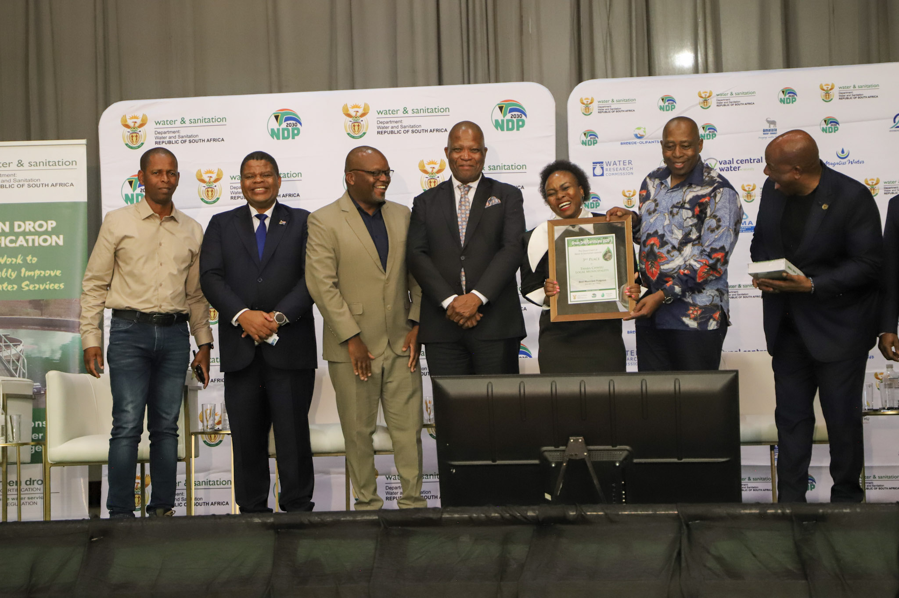
Thaba Chweu Local Municipality 3nd runner up “Most improved WSA”
from 10 % (critical) in 2022 to 57% (Average) in
2025 Green Drop Performance

Slide 17
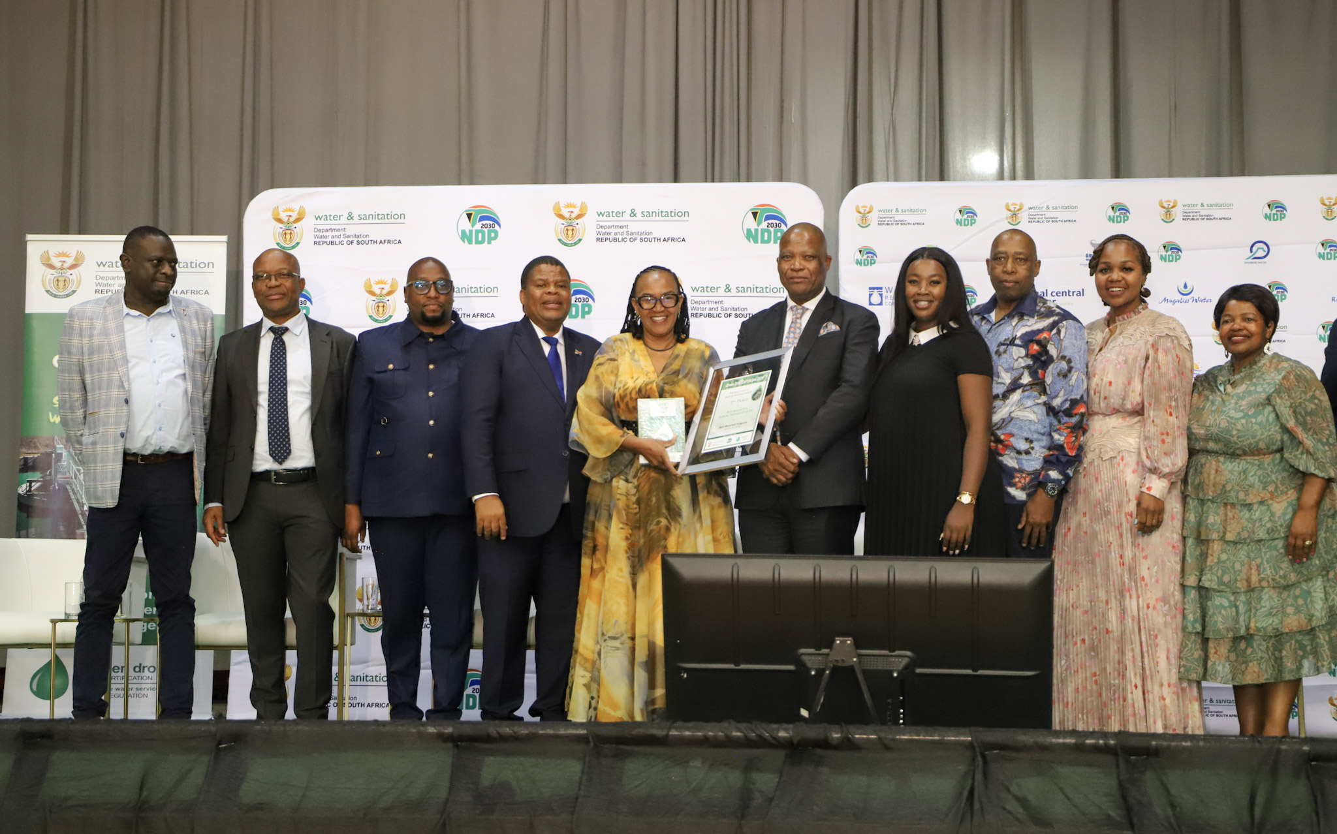
Msukaligwa Local Municipality 2nd runner up “Most improved WSA”
from 17 % (critical) in 2022 to 66% (Average) in
2025 Green Drop Performance

Slide 18
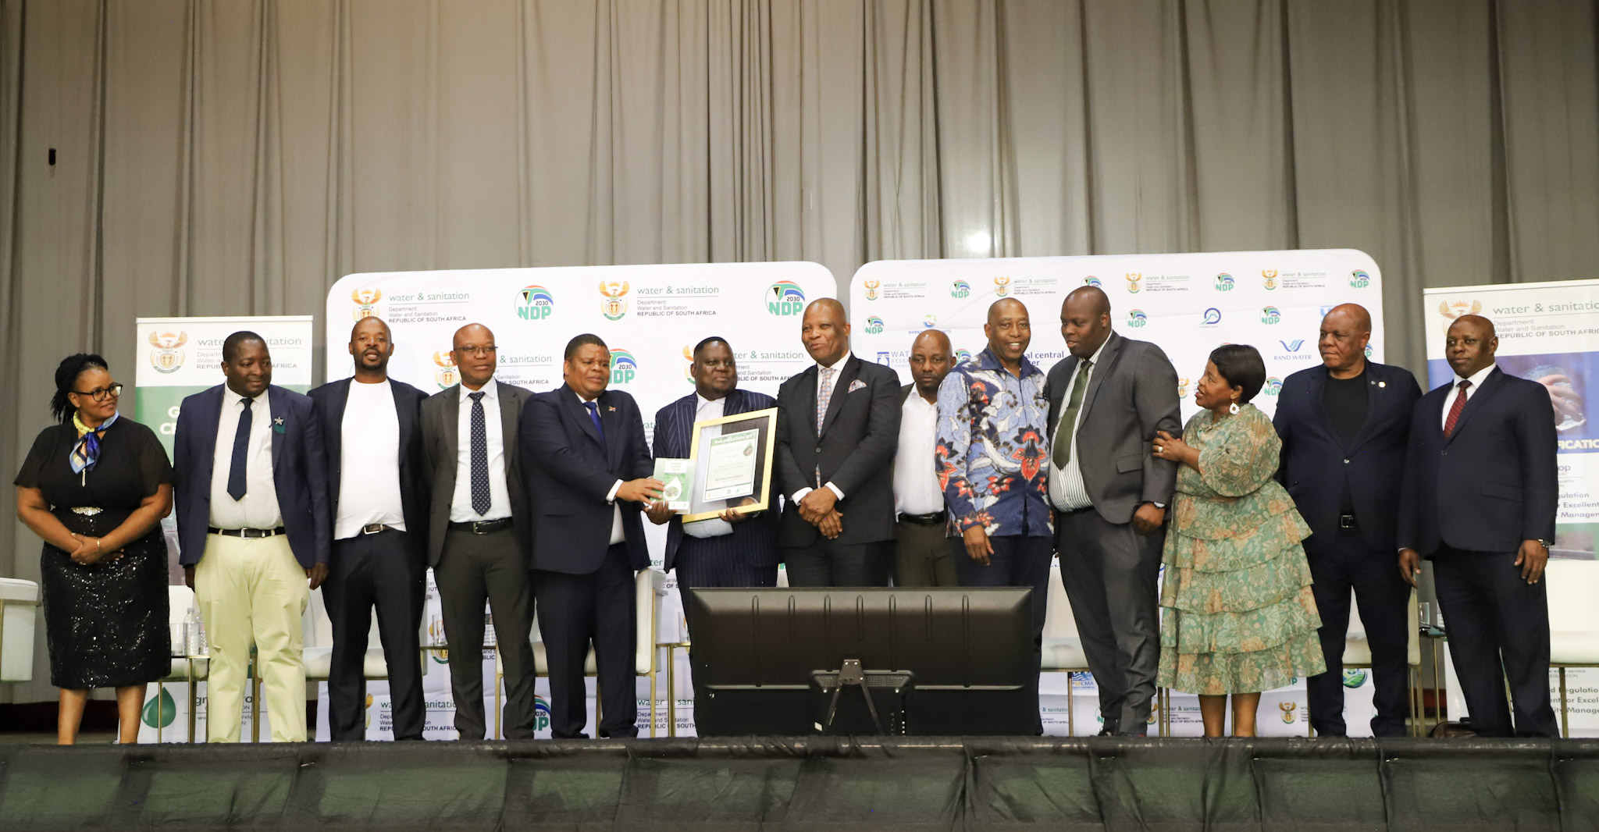
Albert Luthuli Local Municipality “Most improved WSA” from 11 % (critical) in 2022 to 71% (Average) in
2025 Green Drop Performance

Slide 19
Theme 4: Building partnerships through building water sensitive and resilient communities
In the two major urban areas in the country where the demand for water is exceeding the available supply, DWS has put in place partnerships with business and civil society leaders who work together to create a common communications and awareness campaign regarding the need to use water sparingly
Approximately 60% of WSAs indicate that they have at least initiated processes to to have climate change and disaster management plans in place
The Ministry and the Department has worked with several Western Cape towns to avert day zero and provided the necessary disaster management support for the provinces of Mpumalanga and Limpopo during the recent floods
The majority of WSAs report working with business and civil society leaders
19

Slide 20
Theme 5: Fighting criminality and corruption in the water and sanitation sector
60% of WSAs reported that they indicate that they have at least initiated processes to develop a infrastructure strategy with 20% implementing infrastructure security strategies or plans to combat vandalism and theft of water and sanitation infrastructure
Most WSAs reported implementing community and awareness programmes with more than half of WSAs having at least initiated processes to establish water committees
The SIU has partnered with DWS and other institutions in the water sector to establish a water and sanitation anticorruption forum
To address the problem of the water tanker mafia, DWS is encouraging all WSAs to insource water tankers. In this we acknowledge progress made by City of Tshwane, eThekwini and Polokwane in insourcing tankers to reduce the opportunity of corruption
In June 2025 the South African Human Rights commission (SAHRC) released a comprehensive policy brief to tackle ‘Water Mafias’ and the systemic sabotage of essential water infrastructure. Deputy Minister Mahlobo addressed and participated in a SAHRC webinar hosted on 29 July 2025 on the impact of sabotage on essential water infrastructure and water mafias indicating the Department’s role and leadership in collaborating with law enforcement and developing strategies of community engagement and advocacy
20

Slide 21
Way forward
In general, good progress is being made with implementation of the resolutions for which national government is responsible
The resolutions for which WSAs are responsible relate to basic activities that WSAs should be implementing to deliver reliable water and sanitation services which meet minimum standards. However, many of the WSAs are not making significant progress in implementing these resolutions, particularly municipalities in the Northern Cape
Often municipalities have plans in place but are not implementing them
Half of WSAs with submitted Corrective Action Plans indicate that they have not yet implemented more than 50% of the one or more corrective action plans (CAPs), to address poor performance in terms of either the Blue, Green or No Drop reports and it shows in the outcomes of the 2025 Full Green Drop and Blue Drop and No Drop Progress reports
Where a wastewater system(s) has scored less than 31% a Corrective Action Plan must be submitted within 60 working days from the release of the report (30 June 2026). Where the relevant system was already found to be in a critical state of performance in the 2022 Green Drop report and a Corrective Action Plan has already be in the process of implementation this plan should be reviewed to ensure any additional findings or insufficient progress can be addressed. In responding to the Department a progress report with any revisions of the CAP must be submitted on or before the due date.
Where the relevant system is in a critical state of performance for the first time the Water Services Institution must prepare a CAP that addresses the findings per Key Performance Indicator. The Department through the relevant Regional Office can be contacted for guidance on content
Failure to submit CAPS as guided above will result in the Department taking the necessary enforcement action under the National Water Act
21

Slide 22
Way forward (2)
To align timeframes and reporting of metropolitan municipalities performance for Metro Trading Services Reform the Department will be conducting annual full Blue Drop and Green Drop Assessments shortly after the finalised audits of their financial statements of the current municipal financial year
As pronounced in the State of the Nation address the President established and is chairing the National Water Crises Committee (Watercom). Work has commenced in earnest and the National Water Action Plan will be released soon
Most of the resolutions agreed to in the 2025 Indaba remain integral in addressing the national water crises and will find expression in the National Water Action Plan and the Watercom will continue with steering and tracking progress against them with the assistance of the Department’s regional offices
22

Slide 23
PRESENTATION TITLE
THANK YOU
Presented by: Anet Muir
Designation: CD WUCME
Date:24 09 19

Slide 24
Annexure: 2025 Indaba Resolutions
PRESENTATION TITLE
Water Security and Provision Resolutions
Presented by: Anet Muir
Designation: CD WUCME
Date:24 09 19

Slide 25
Theme 1 Delivery implementation models
1.1 DWS to complete the full establishment of the National Water Resource Infrastructure Agency by mid-2026
1.2 DWS to complete the full establishment of Catchment Management Agencies by July 2025
1.3 All WSAs to implement a utility model for water and sanitation to ensure operational efficiency without losing municipal ownership, within three years (a utility can be a ring-fenced internal department, municipal entity, water board, special purpose vehicle, or concession, amongst other options)
1.4 SALGA, COGTA and DWS to implement the plan that has been developed for a coordinated Municipal Systems Act Section 78 consultative process according to the timeframes in the plan. This should lead to the appointment of capable Water Service Providers
1.5 As part of good governance and compliance with the law, all WSAs to separate their WSA and WSP functions and account for them separately within a year (Council resolutions in this regard should be taken within three months)
1.6 All metropolitan municipalities to implement the Reform of Metropolitan Trading Services Programme - establish or appoint ring-fenced, professionally managed utilities (internal or external) for water & sanitation within two years, with support from National Treasury and line departments
1.7 COGTA to review the current institutional structure of local government, including the appropriateness of the two-tier system, following which COGTA to review the allocation of WSA status to municipalities
1.8 DWS to finalise Water Services Act amendments and table to Parliament by May 2025. Following this, DWS to put in place an operating licensing system for Water Services Providers by June 2026
25

Slide 26
Theme 1 Delivery implementation models (2)
1.9 DWS to provide guidance to WSAs on the different options for external WSPs, on request from April 2025
1.10 DWS to issue guidelines on the roles and functions of WSAs versus WSPs by April 2025
1.11 DWS and AWSISA to develop a plan for building Water Boards’ capacity and readiness to provide a retail WSP function to WSAs if requested, informed by a capacity assessment of the Water Boards, by end July 2025
1.12 National Government (Presidency, National Treasury, COGTA and DWS), working with SALGA, to review the intervention and support model for local government in terms of Section 154 and 139 of the Constitution and Section 63 of the Water Services Act, within two years
1.13 DWS to finalise amendments to National Water Act and submit to Parliament within 6 months, including legislating the use-it-or-lose it principle for water use licenses
26

Slide 27
Theme 2: Increasing investment through financing options and ensuring financial viability
2.1 All government departments to pay correct invoices from municipalities within three months and municipalities to apply stringent credit control measures on government departments that do not pay
2.2 All WSAs to pay their current invoices in full to the Water Boards timeously, immediately
2.3 All Water Boards to pay their current invoices in full to DWS, starting immediately
2.4 DWS and water boards to implement the approved debt write-off mechanism with qualifying municipalities, starting immediately
2.5 National Treasury to finalise the review of the funding model for local government
2.6 DWS to implement the revised Raw Water Pricing Strategy by 1 April 2026
2.7 DWS to establish an independent economic water regulator to regulate water prices across the water value chain, within three years
2.8 All WSAs/WSPs which do not yet have non-revenue water programmes, to have these in place by May 2025, covering:
Budgets for maintenance and for reducing leaks in water distribution systems
Ensuring that all reported leaks are fixed quickly
Closing illegal water connections
Replacing old leaking pipes, including asbestos pipes (which are a danger to health)
Improving management of water systems (through pressure management for example)
Strengthening metering, billing and revenue collection, including ensuring that billing systems are accurate.
27

Slide 28
Theme 2: Increasing investment through financing options and ensuring financial viability (2)
2.9 All WSAs which have not yet ringfenced revenues from the sale of water for the water function to take resolutions to their Councils in this regard within 6 months
2.10 DWS to arrange provincial workshops with all WSAs in each province to develop a common understanding of what is meant by “ringfencing”
2.11 All WSAs to review their indigent registers and ensure the provision of free basic water to the indigent within two years. All other water users to be billed and revenue to be collected from all other users
2.12 WSAs or WSPs to consider partnerships with the private sector, drawing on the support of the Water Partnerships Office, starting immediately
2.13 DWS and the Water Partnerships Office to develop Green and Blue Bond financing mechanisms with the private sector, for implementation by Catchment Management Agencies and WSAs, starting immediately
2.14 DWS, the Water Boards and WSAs to increase their collaboration with the Infrastructure Fund to put in place more blended finance water projects, over the next three years
2.15 DWS and the Water Boards to develop additional non-commercial water provision partnerships with industrial sectors, such as the Olifants Management Model project in Limpopo with mining houses, starting immediately
2.16 DWS to develop mechanisms to leverage private sector finance using the Regional Bulk Infrastructure Grant and Water Services Infrastructure Grant, to be in place by the 2026/27 financial year
2.17 DWS and COGTA to engage with National Treasury to review water and sanitation conditional grants with a view to addressing the challenge of maintenance of water and sanitation infrastructure, within six months
28

Slide 29
Theme 3:Enhancing and Strengthening technical and operational capacity and efficiency
3.1 All WSAs which have not yet submitted Corrective Action Plans (CAPs) to address their Drop report results to submit to DWS by end of May 2025
3.2 DWS to verify all reports submitted by WSAs of progress against the January 2024 Summit resolutions, within 4 months
3.3 All WSAs which have not yet started implementation of the CAPs to do so by June 2025
3.4 DWS to monitor implementation of the CAPs and escalate to political leaders where necessary
3.5 All WSAs to put in place plans to reduce demand, through communications campaigns and stakeholder engagements aimed at behaviour change, water restrictions and tariffs and technical interventions such as flow restrictors, pressure management and leak reduction, within a year
3.6 All WSAs to implement leak detection and repair programmes to improve reliability through improving leak repair turnaround times; prioritizing the leaks which result in the highest losses, while fixing other leaks; and costing and implementing a programme of pipe replacement so that infrastructure remains within its design life
3.7 WSAs with demand for water exceeding available supply to consider putting in place and enforcing water restrictions, and step-tariffs or punitive tariffs for high-volume non-industrial users, with immediate effect
3.8 All WSAs/WSPs which do not yet have water conservation and demand management programmes in place to have these in place by May 2025
29

Slide 30
Theme 3:Enhancing and Strengthening technical and operational capacity and efficiency
3.9 All WSA to put in place climate change and disaster response plans within a year
3.10 Any Water Services Authorities which are not yet issuing advisory notices without fail when their drinking water quality fails to meet drinking water standards must do so immediately
3.11 Water and sanitation infrastructure grants to WSAs must be refocused on increasing access to a basic level of services, starting in the 2025/26 financial year
3.12 All WSPs to ensure that asset management plans are in place, including maintenance plans, within a year
3.13 All WSAs to ensure that their maintenance and repairs teams have the necessary tools of trade, within two years
3.14 All WSAs/WSPs to implement the local government professionalization framework, in terms of timeframes set by the Department of Cooperative Governance
3.15 DWS to develop minimum competency regulations for water service providers and water services authorities and issue them by end of 2026 financial year
3.16 COGTA to review municipal staff regulations to align them with the reforms taking place in the water sector
3.17 All WSAs to prioritise creation and filling of key technical positions (process controllers, artisans, scientists and engineers) on an ongoing basis
30

Slide 31
Theme 3:Enhancing and Strengthening technical and operational capacity and efficiency
3.18 All WSA’s to review their bylaws with regard to enforcement of water and sanitation policies in line with national norms and standards, and address gaps within the next year
3.19 All CMAs to finalise Catchment Management Strategies within a year, including dealing with erosion and silting of dams, which reduce dam capacity
3.20 DWS will finalise the revised National Water Resource Strategy within the timeframes set by the National Water Act.
31

Slide 32
Theme 4: Building partnerships through building water sensitive and resilient communities
4.1 DWS, water boards and WSAs to work with business and civil society leaders to raise awareness of the need to use water sparingly, starting immediately, drawing lessons from the success stories of collective action in averting water crises in the cities of Cape Town and Nelson Mandela Bay
4.2 DWS to implement a communications and awareness campaign regarding the need to use water sparingly, in collaboration with business and civil society leaders and all spheres of government, starting immediately
4.3 DWS to explore incentives for the agriculture sector and other sectors to use less water (such as through using efficient/precision irrigation systems) – proposals to be developed and submitted to Cabinet system within 6 months
4.4 WSAs to work with local business and civil society leaders to address water and sanitation challenges, drawing on the lessons of the successful Presidential Business Working Group in eThekwini, on an ongoing basis
32

Slide 33
Theme 5: Fighting criminality and corruption in the water and sanitation sector
5.1 All WSAs that have not yet developed an infrastructure security strategy/ plan to combat vandalism and theft of water and sanitation infrastructure to have these in place within 6 months
5.2 DWS to collaborate with Special Investigating Unit to establish a national water and sanitation anti-corruption forum, within 6 months
5.3 WSAs to implement community education and awareness programmes to raise the implications of theft and vandalism on water infrastructure, starting within the next 6 months
5.4 WSAs to consider establishing water committees to protect water and sanitation infrastructure, within a year
33

Slide 34
Annexure:
PRESENTATION TITLE
Water and Sanitation Grant Allocations
Presented by: Anet Muir
Designation: CD WUCME
Date:24 09 19

Slide 35
Breakdown of water services related grants: FY 2026/27
Funding stream | Total (Rm) | Water (Rm) | Conditionality mechanism
(1) CONDITIONAL GRANTS: DoRB Schedules 4B, 5B & 6B
Urban Dev. Financing Grant (UDFG)* | 9 024 | 4 632 | Performance-based — 60% water and sanitation allocation set in DoRB (value reflects proportion set aside for water only)
Urban Settlements Dev. Grant (USDG) | 4 079 | — | Conditional — no mandatory water split
Informal Settlements Upgrading (IUSP) | 4 417 | 1 193 | Conditional — 27% water allocation set in DoRB (56% water and sanitation)
Regional Bulk Infrastructure (RBIG) | 3 902 | 3 902 | DWS Schedule 6B — direct spend, 100% water, bypasses municipalities
Water Services Infrastructure (WSIG) | 4 389 | 4 389 | DWS Schedule 6B — direct spend, 100% water, bypasses municipalities
Integrated Urban Dev. Grant (IUDG) | 1 379 | 372 | Conditional — 27% water allocation set in DoRB (56% water and sanitation)
Municipal Infrastructure Grant (MIG) | 17 504 | 4 726 | Conditional — 27% water allocation set in DoRB (56% water and sanitation) municipalities must show targets
DWS direct components (Sch. 6B) | 5 085 | 4 849 | DWS direct spend — full control, bypasses failing municipalities
SUBTOTAL: Conditional Grants | 49 780 | 24 063 | DoRA Act 2 of 2025
(2) LOCAL GOVT EQUITABLE SHARE (LGES) (subsidy)
LGES to all 257 municipalities | 110 100 | ~31 100 | Estimated component to fund the provision of free basic water services to the indigent (one third of subsidy)
TOTAL ESTIMATED WATER FUNDING |  | ~55 163 | Conditional Grants and Subsidies available to water
*The allocation for the Metro Trading Services Reform comes directly from the UDFG

Slide 36
Annexure:
2025 No Drop: List of WSA that did not submit an IWA water balance, List of WSAs with improved %NRW, Map indicating %NRW

Slide 37
2025 List of WSAs that did not submit an IWA water balance
Province | Name of WSA
Free State | Dihlabeng LM
 | Kopanong LM
 | Letsemeng LM
 | Mafube LM
 | Mantsopa
 | Masilonyana LM
 | Mohokare LM
 | Moqhaka LM
 | Ngwathe LM
 | Tokologo LM
KwaZulu-Natal | Amajuba DM
Limpopo | Capricorn DM
 | Mopani DM
 | Sekhukhune DM
 | Thabazimbi LM
 | Vhembe DM
Mpumalanga | Emakhazeni LM
Province | Name of WSA
Northern Cape | Dikgatlong LM
 | Kai Garib LM
 | Kamiesberg LM
 | Karoo Hoogland LM
 | Kgatelopele LM
 | Khai-Ma LM
 | !Kheis LM
 | Magareng LM
 | Phokwane LM
 | Renosterberg LM
 | Richtersveld LM
 | Siyancuma LM
 | Siyathemba lM
 | Thembelihle LM
 | Tsantsabane LM
Province | Name of WSA
North West | Dr Ruth Segomotsi Mompati DM
 | Kgetlengrivier LM
 | Moses Kotane LM
Western Cape | Beaufort West LM
 | Swellendam LM
Total WSAs | 37

Slide 38
List of WSAs with improved percentage NRW
Province | Name of WSA | 2023 | 2025
Eastern Cape | Ndlambe LM | 41.0% | 39.1%
 | O R Tambo DM | 65.2% | 59.4%
Gauteng | City of Ekurhuleni | 30.9% | 29.8%
KwaZulu-Natal | eThekwini Metro | 58.3% | 53.8%
 | Newcastle LM | 36.8% | 35.1%
Mpumalanga | Steve Tshwete LM | 29.4% | 24.6%
 | Victor Khanye LM | 66.1% | 45.3%
North West | Rustenburg LM | 49.7% | 48.1%
 | City of Matlosana LM | 67.6% | 57.6%
Western Cape | City of Cape Town | 30.1% | 24.3%
 | Matzikama LM | 40.2% | 37.7%
 | Bergrivier LM | 15.2 | 12.1%
 | Theewaterskloof | 51.8% | 47.7%

Slide 39
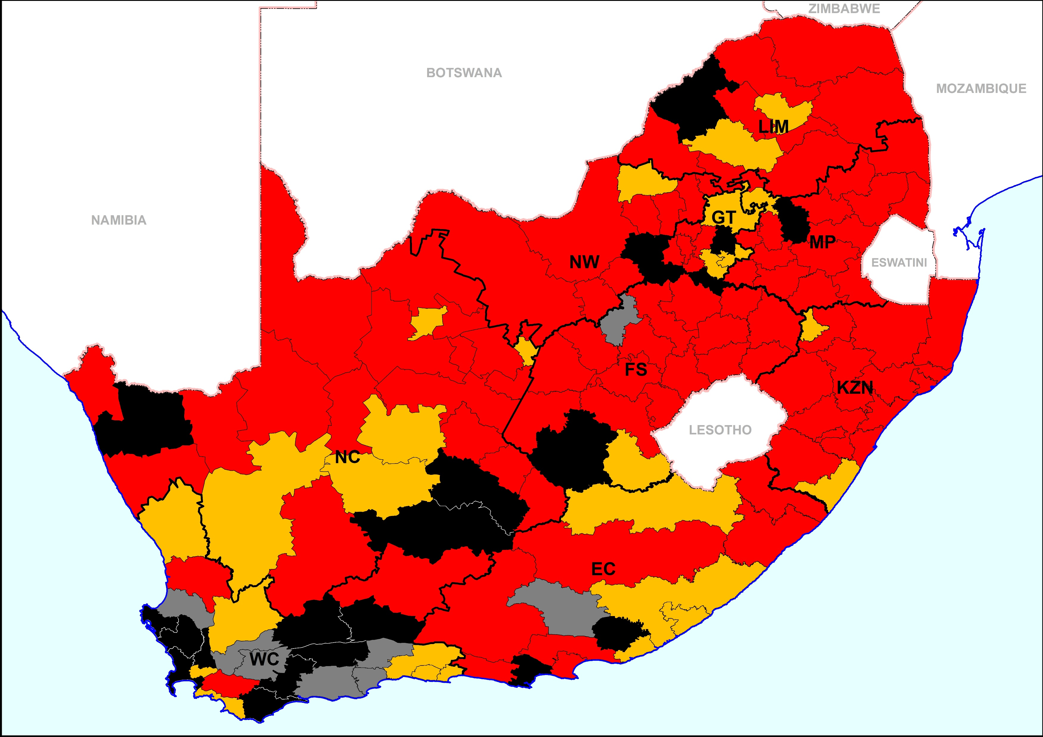
2025 No Drop PAT: percentage NRW per WSA
% NRW performance categories
 | >40% | Extremely poor
 | 30-40% | Poor
 | 20-30% | Average
 | 10-20% | Good
 | <10% | Excellent
Province | 2023 % NRW | 2025 %NRW
EC | 50.6 | 46.8
FS | 59.5 | 56.6
GP | 49.2 | 47.9
KZN | 60.5 | 60.0
LP | 57.7 | 46.9
MP | 54.9 | 60.6
NC | 49.0 | 48.9
NW | 55.6 | 53.9
WC | 27.6 | 28.5
National | 47.4 | 47.3

Slide 40
Distribution of Water Services Authorities in 2024 Water Summit and 2025 Water and Sanitation Indaba
Water Service Authorities were grouped based on performance measured in the 2023 Full Blue Drop and 2022 Full Green Drop (2024) assessments
Group 1 (2a) This group consists of 67 municipalities that scored critical on average across their water supply systems and/or wastewater systems in the above mentioned assessments
Group 2 (2b) This group consist of thirty-eight municipalities that scored poor on average across their water supply systems and/or wastewater supply systems in the above mentioned assessments
Group 3 (2c in 2025) This group consists of 27 municipalities that scored average across their water supply systems in the above mentioned assessments
Group 4 (2d in 2025): This group consist of twelve municipalities which either scored good or excellent on average across their water supply systems and wastewater systems in the above mentioned assessments
The provincial reports provided today reflects all four groups within the relevant provincial boundary

Slide 41
Distribution of Water Services Authorities in 2024 Water Summit and 2025 Water and Sanitation Indaba
Summit Group Nr (2024) | Indaba Group Nr (2025) | Description | Number of WSAs
1 | 2a | WSAs that scored critical on average | 69
2 | 2b | WSAs that scored poor on average | 38
3 | 2c | WSAs that scored average on average | 27
4 | 2d | WSAs that scored good or excellent on average | 12

